Slide 1
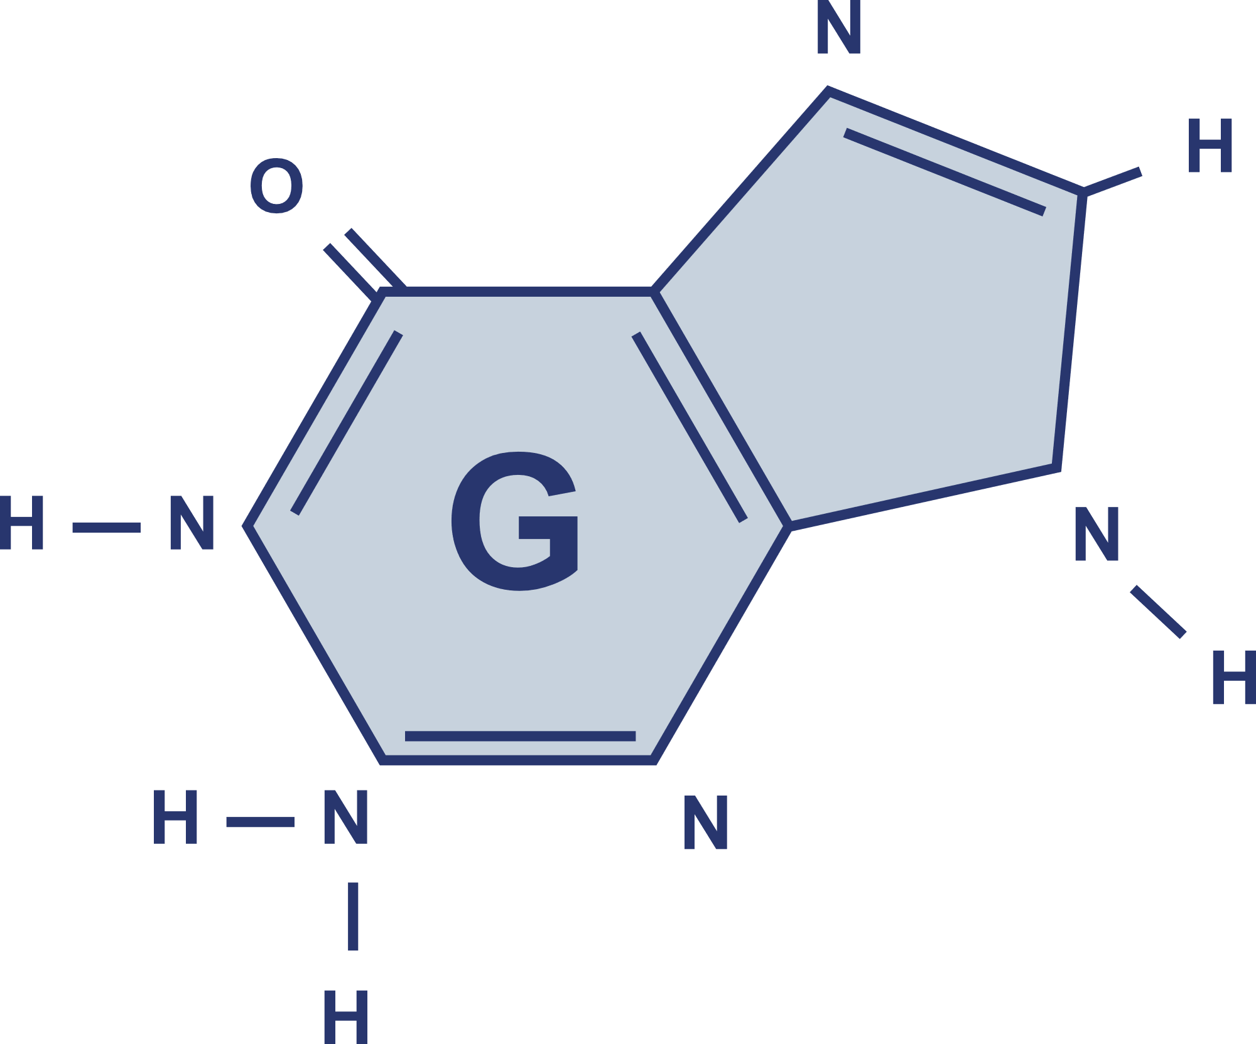
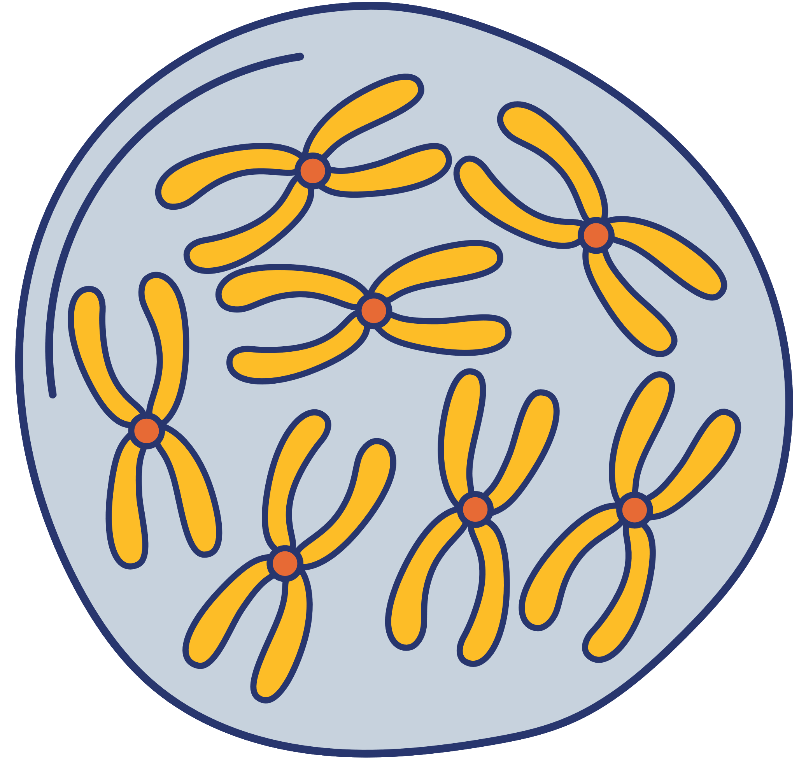

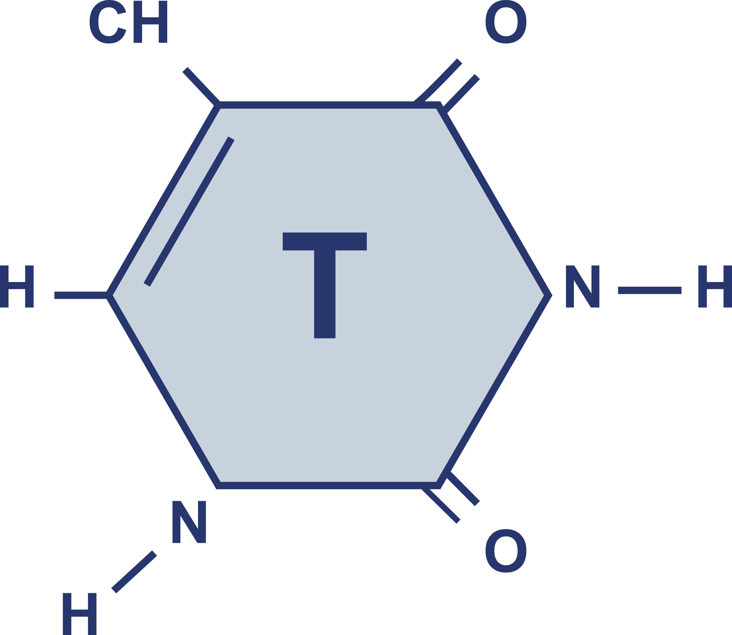
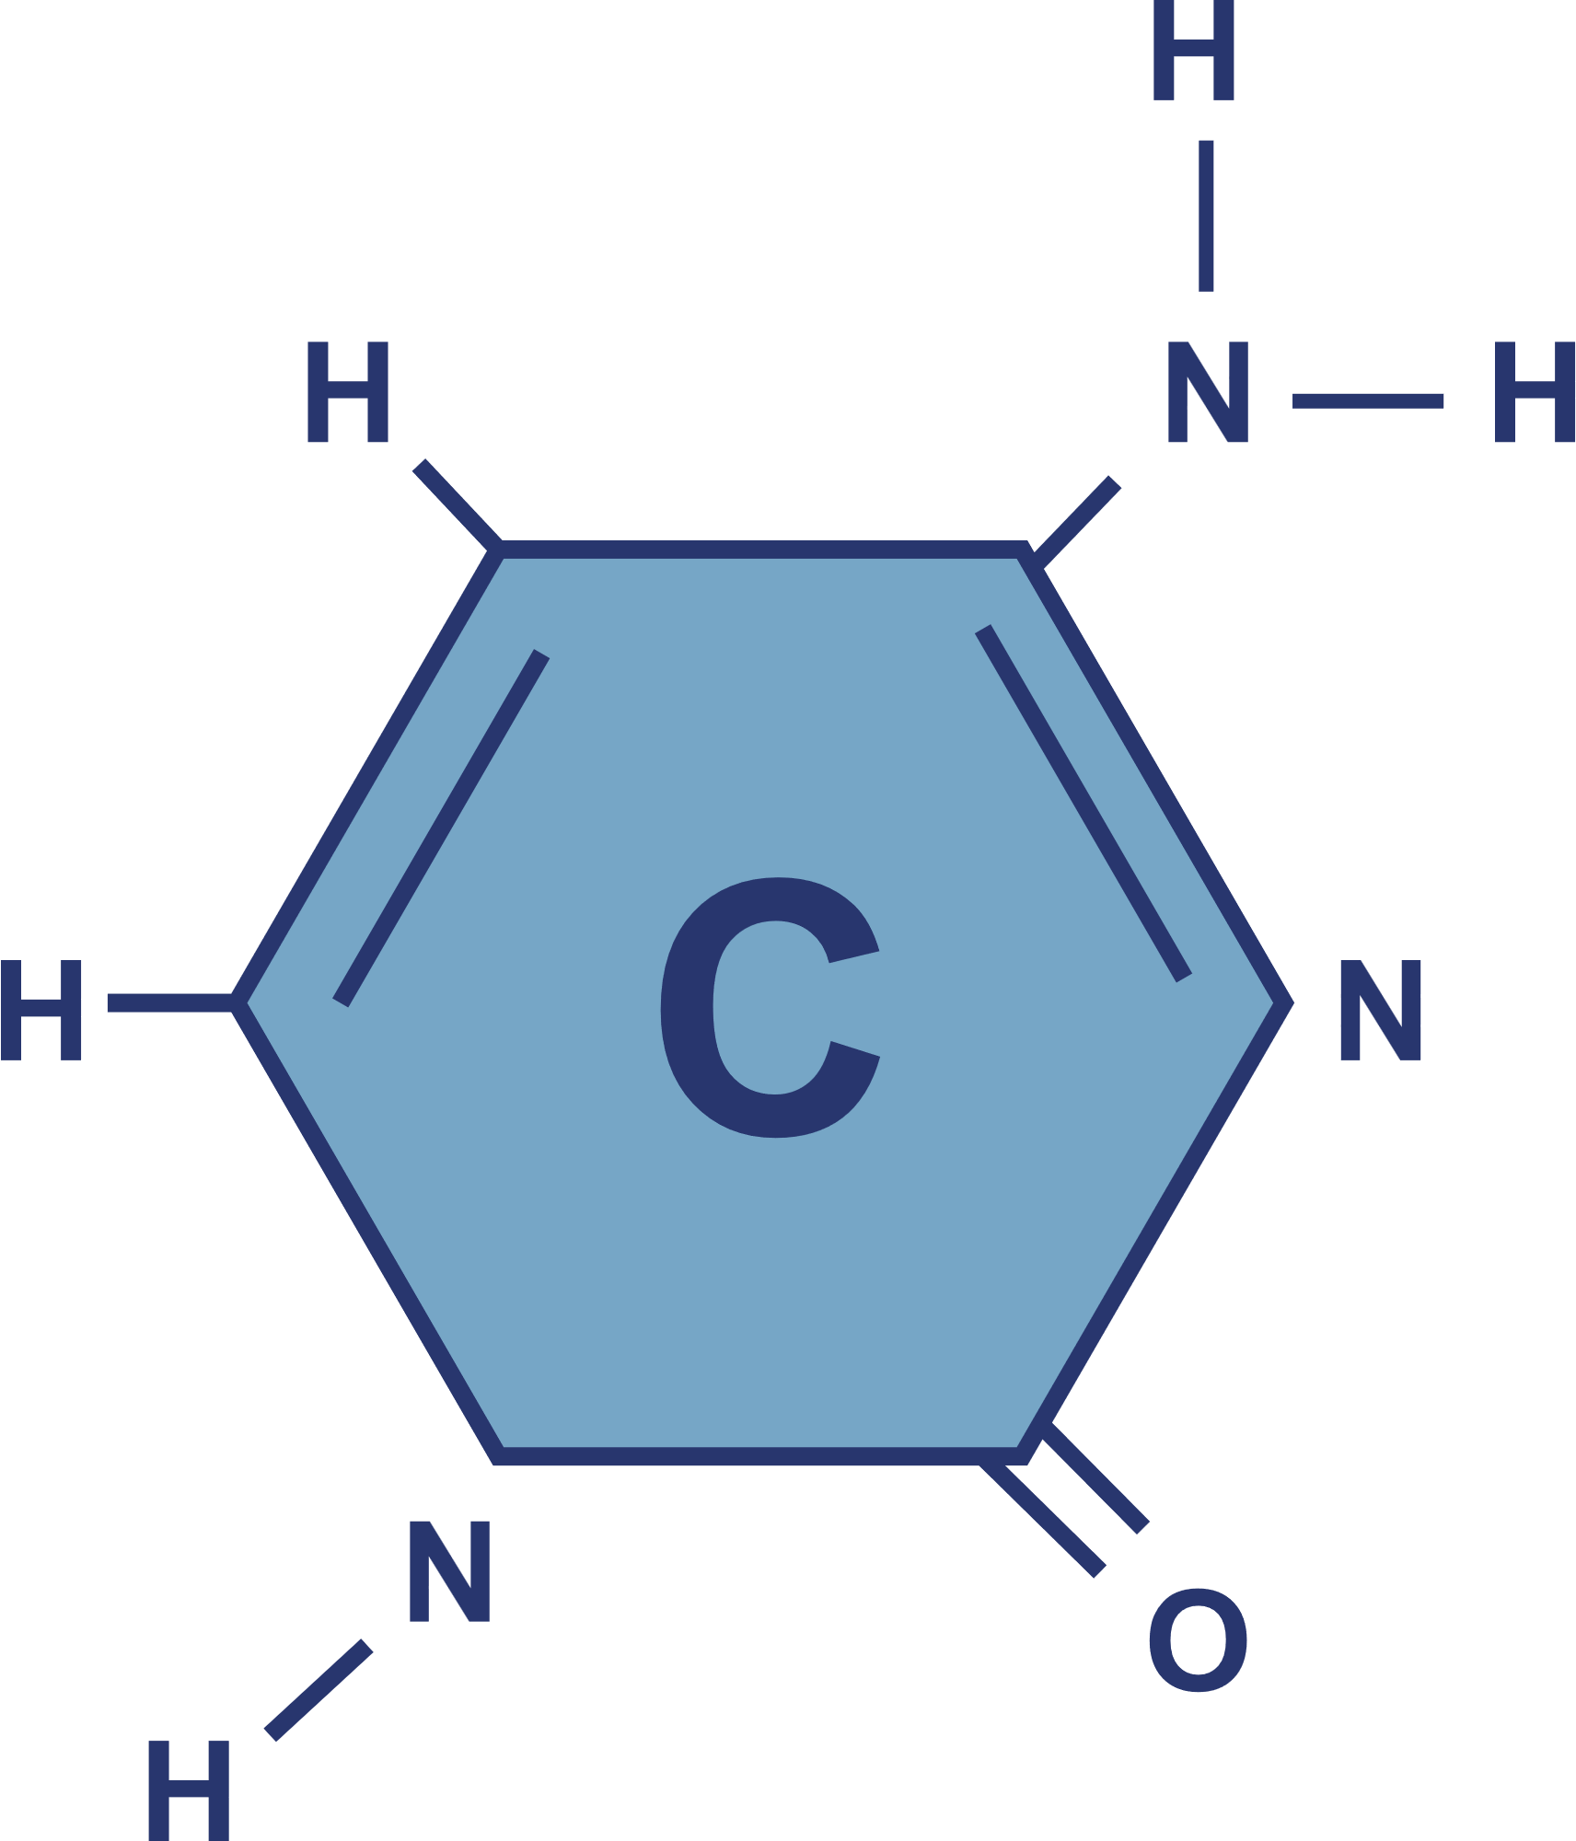



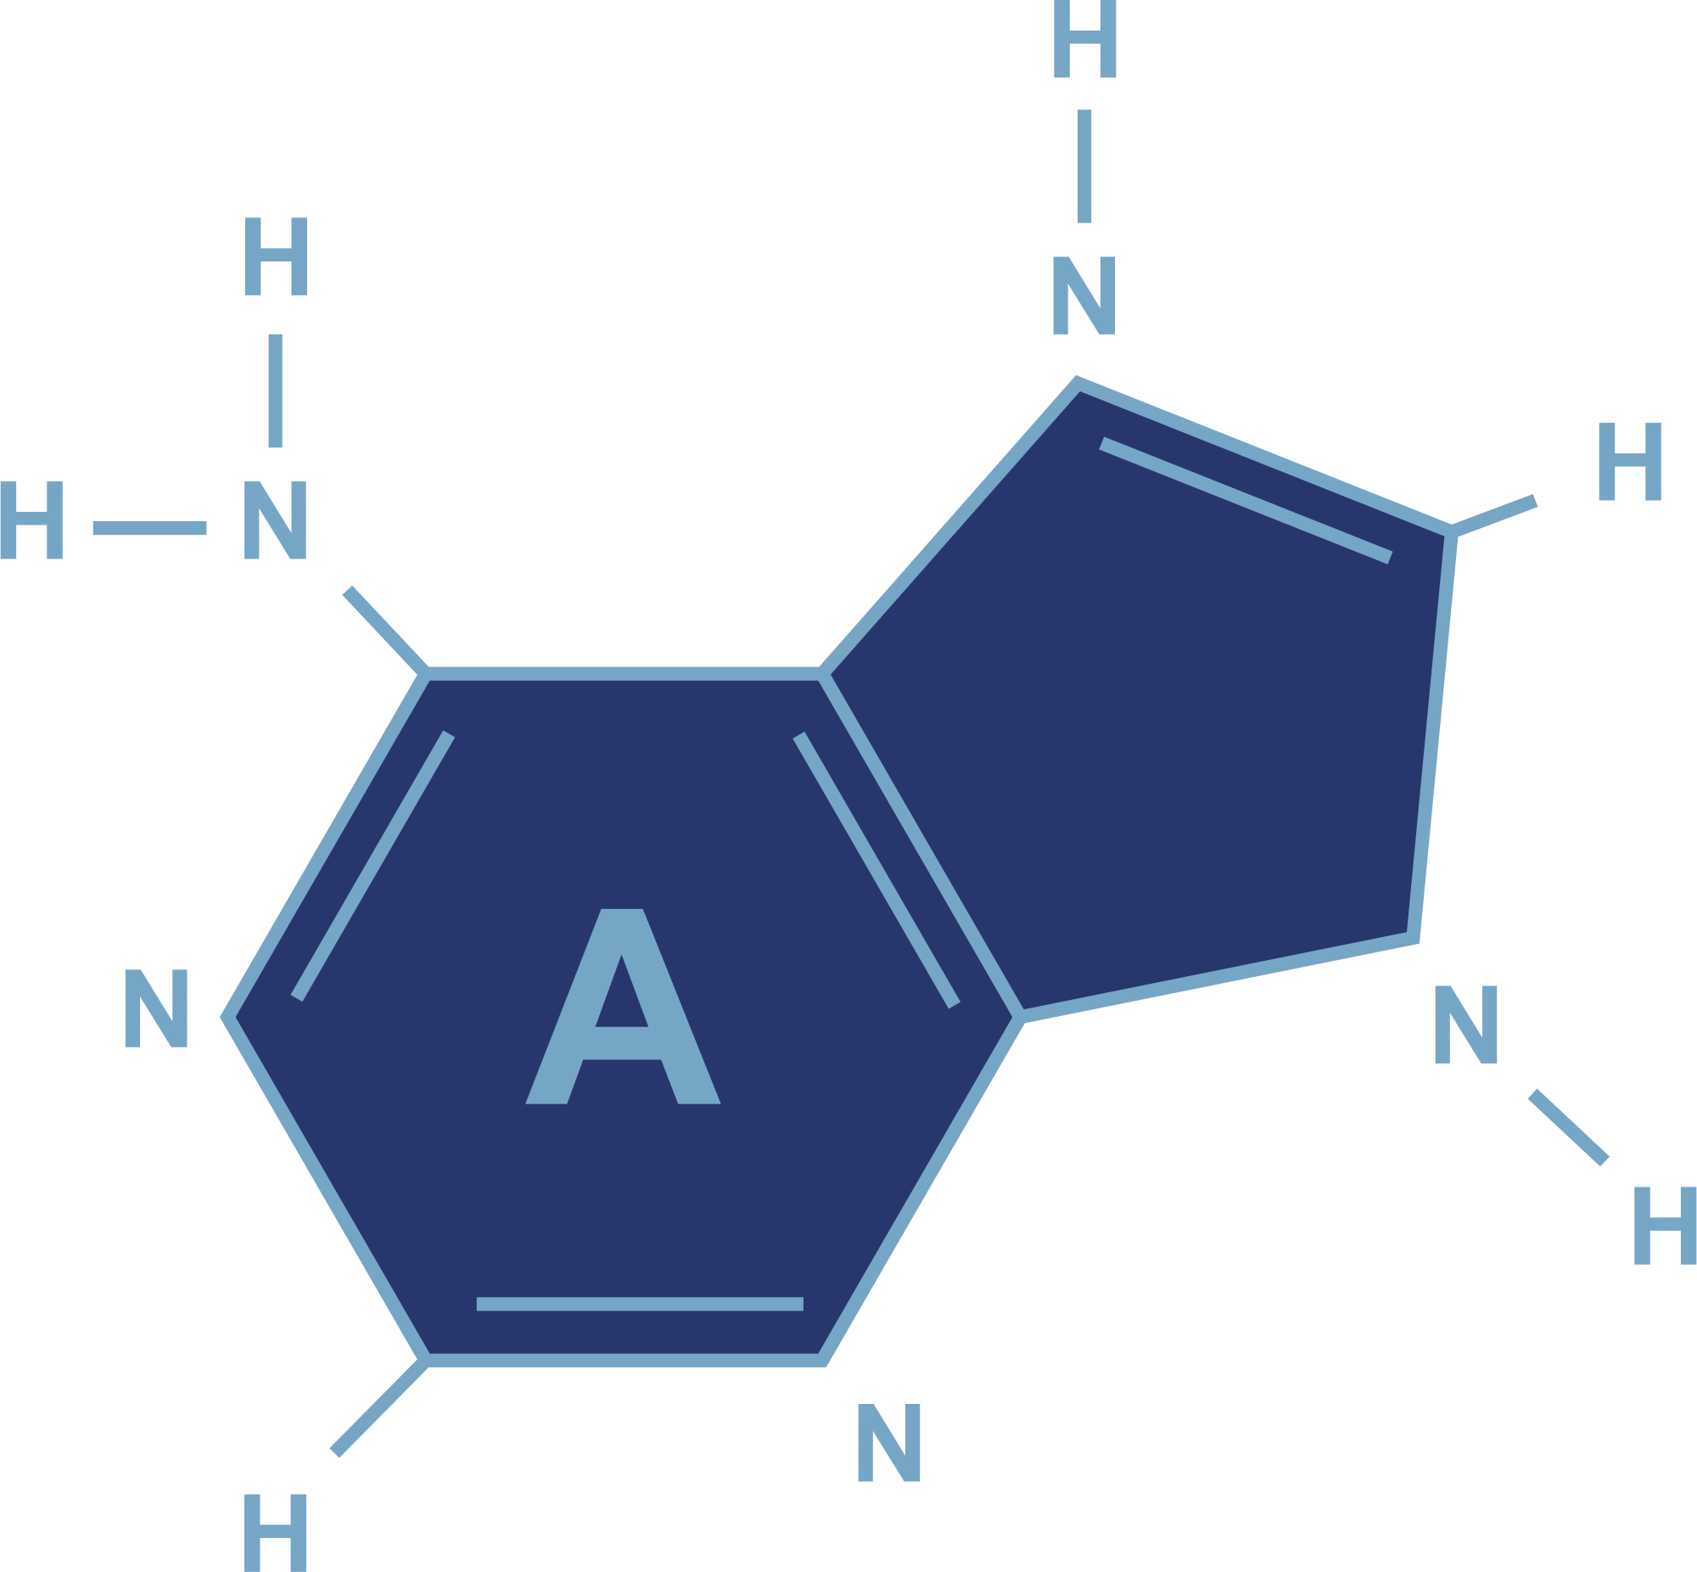
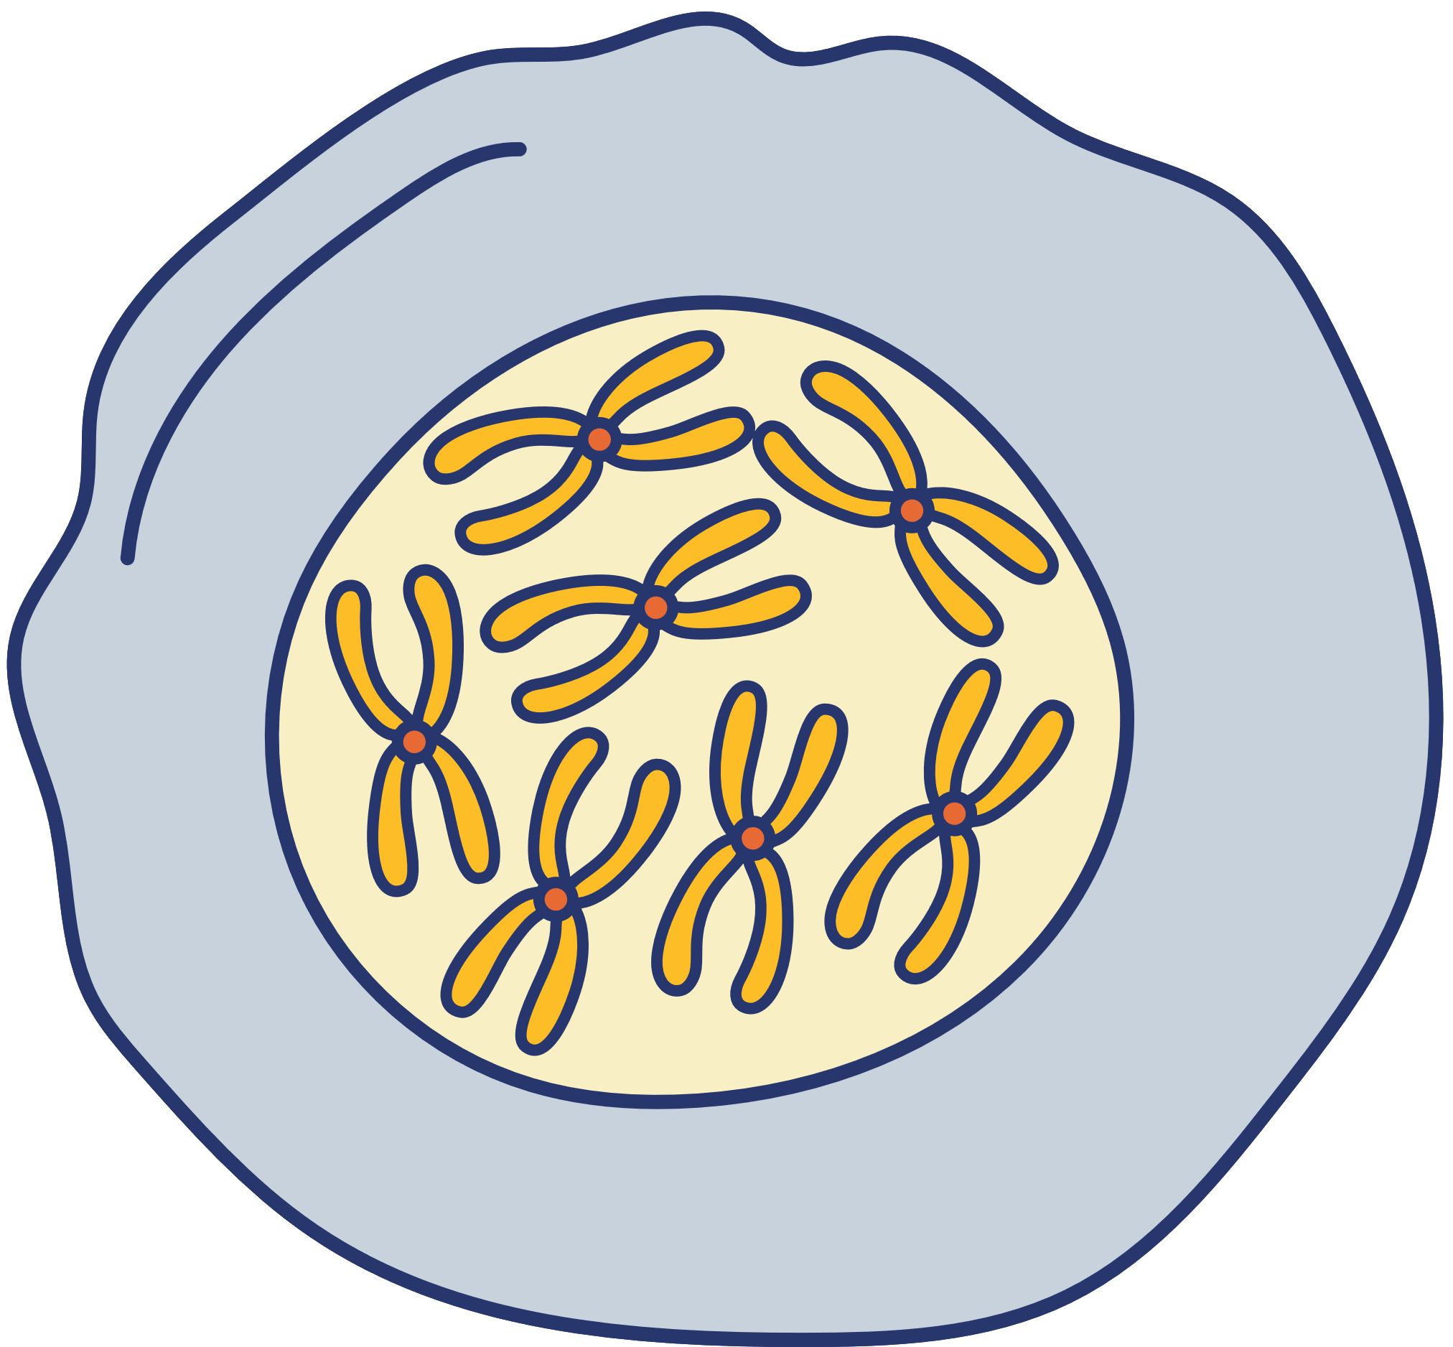
“Identifying Genes Influencing Phenotype”
ANALYTICA
SAURAB LAD – A030
SHRUTI KHAPEKAR – A028
SANDESH TAYDE – A070

Slide 2
OBJECTIVE
1. Determining the gene that significantly impact the phenotype of the mice.
2. Implementing screening method to reduce number of covariates (genes).
3. Comparing the performance of Ridge and Lasso regression and choosing the best method to identify important genes.
4. Use Bayesian regression method for identifying significant genes and compared it with ridge and lasso regression method.

Slide 3
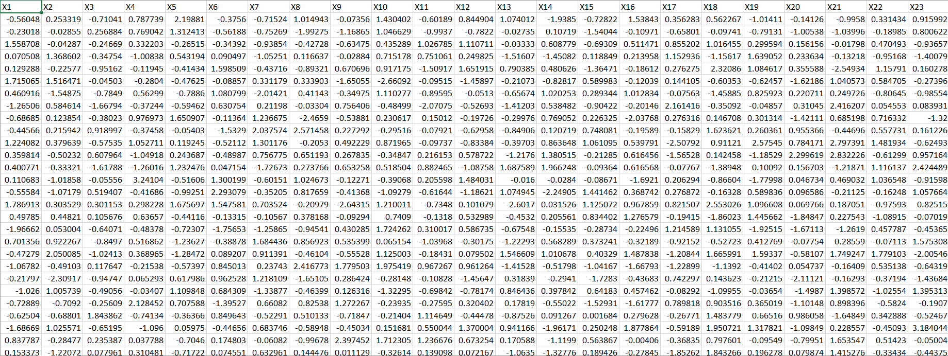
PROBLEM OVERVIEW
DIMENSIONS: 50 × 2000
Variables:
Gene expression data for 2000 genes & Phenotype data

Slide 4
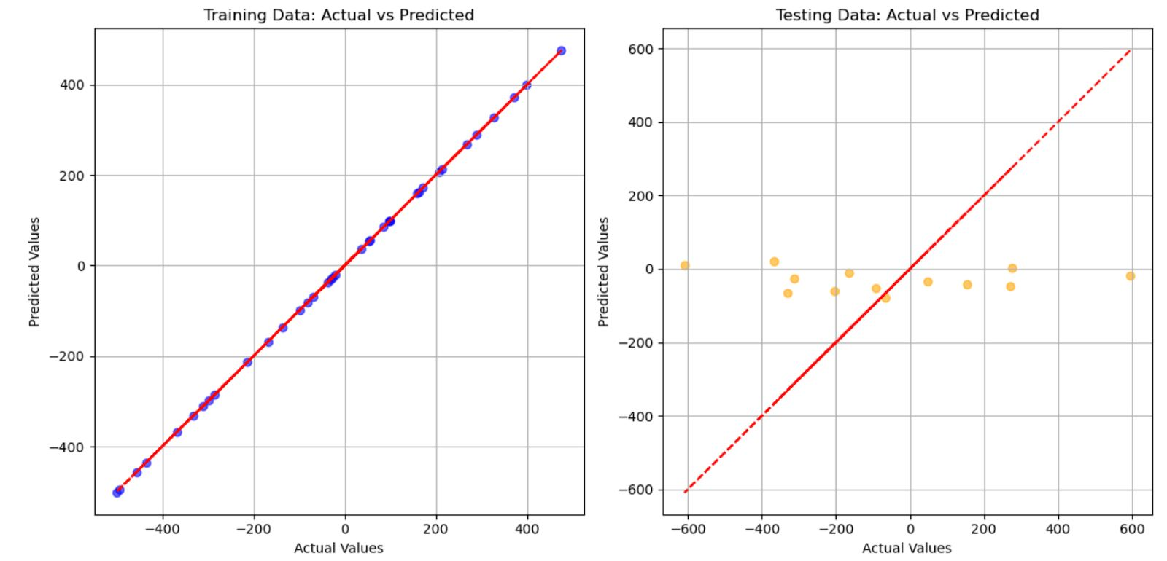
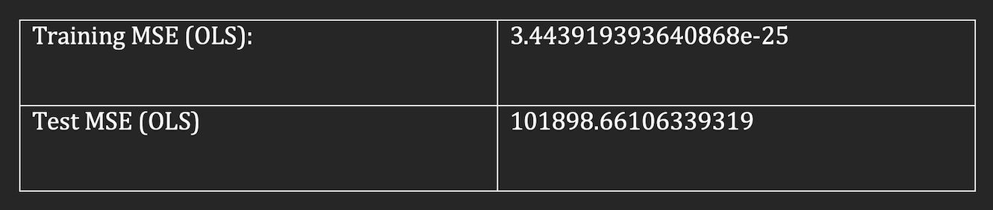
ORDINARY LEAST SQUARE
14
As number of covariate exceeds the number of observations we can clearly say that OLS method is not useful.
Here, ( n = 50 , p = 2000 , n < p ).
Interpretation:
As you can see the model is performing well in training set, but performing very poor in the test set.so the model is getting overfitted. Hence OLS is not suitable for this data set.

Slide 5
CONDITION INDEX
14
For checking the multicollinearity we have use condition number(index):
The condition number of 812676664997782.2 indicates severe multicollinearity (as condition number >30), making OLS unreliable for analyzing the relationship between genes and phenotypes.

Slide 6
INTERCEPT STUDY
USING RIDGE REGRESSION
USING MAXIMUM LIKELIHOOD ESTIMATOR
Root Mean Squared Error (Full Model): 0.9300365655664293
Root Mean Squared Error (Restricted Model): 0.9300365655664291
Root Mean Squared Error (Full Model): 0.001444
Root Mean Squared Error (Restricted Model):
0.001421
The restricted model (without intercept) performs similarly. Intercept may not be necessary.
The genotype at the same time point cannot be equal to zero, hence intercepting the value of phenotype without having knowledge of at least one genotype is not possible.

Slide 7
High Dimensional Regression Approach
The high-dimensional regression methods can be applied to the dataset with 50 observations (mice) and 2000 predictors (genes) which is latter converted into 200 features using simple feature screening method to predict the phenotype trait.
USING RIDGE REGRESSION
Handles multicollinearity effectively by shrinking coefficients, but does not perform feature selection.
USING LASSO REGRESSION
Performs feature selection by removing irrelevant features
USING ELASTIC NET
Elastic Net regression combines the strengths of Ridge and Lasso regression, which involves both penalties 1 and 2.

Slide 8
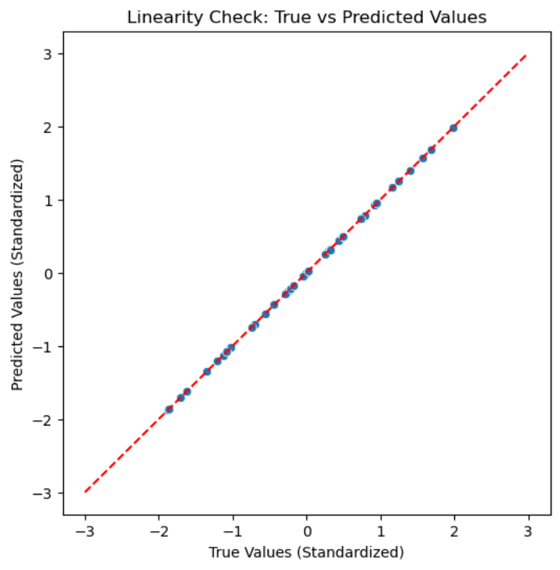
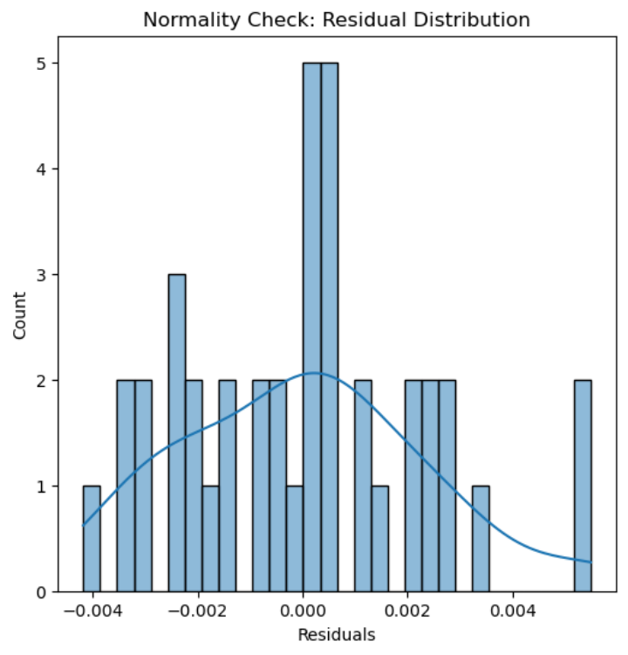
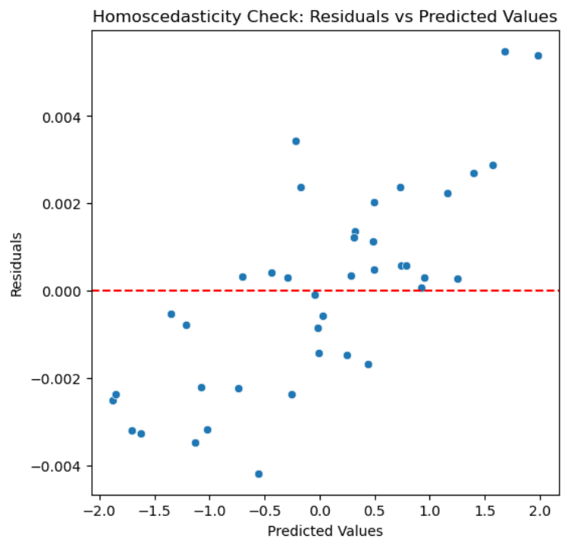
High Dimensional Regression Approach
ASSUMPTIONS
Linearity
Independence of errors
Homoscedasticity
The points lie very close to the
red dashed diagonal line
The assumption of linearity is likely satisfied
Errors should be uncorrelated
and normally distributed.
Variance of the residuals is constant across
all levels of the independent variables.

Slide 9
Covariate Reduction & Model fitting
Correlation Analysis:
Ridge Regression
3. Elastic Net Regression
For Testing data set:
For Testing data set:
Mean squared error | Root Mean squared error | R2_score
0.1144 | 0.33827 | 0.9113
Mean squared error | Root Mean squared error | R2_score
1.1419 | 1.0686 | 0.1149
For Training data set:
For Training data set:
Mean squared error | Root Mean squared error | R2_score
4.6684 e-06 | 0.00216 | 0.9999
Mean squared error | Root Mean squared error | R2_score
0.74104 | 0.8608 | 0.1696
2. Lasso Regression
4. Bayesian Ridge Regression
For Testing data set:
For Testing data set:
Mean squared error | Root Mean squared error | R2_score
1.3116 | 1.1452 | -0.01654
Mean squared error | Root Mean squared error | R2_score
0.1136 | 0.3371 | 0.9112
For Training data set:
For Training data set:
Mean squared error | Root Mean squared error | R2_score
0.89244 | 0.9446 | 0.0
Mean squared error | Root Mean squared error | R2_score
7.11306 e-12 | 2.6703e-06 | 0.9999

Slide 10
Covariate Reduction & Model fitting
2. K Feature Selection Method
2. Bayesian Ridge Regression
Ridge Regression
For Testing data set:
For Testing data set:
Mean squared error | Root Mean squared error | R2_score
0.1136 | 0.3371 | 0.91192
Mean squared error | Root Mean squared error | R2_score
0.1144 | 0.3382 | 0.9113
For Training data set:
For Training data set:
Mean squared error | Root Mean squared error | R2_score
7.11306 e-12 | 2.6703e-06 | 0.9999
Mean squared error | Root Mean squared error | R2_score
4.6684 e-06 | 0.0021 | 0.9999
3. Recursive Feature Elimination
1. Ridge Regression
2. Bayesian Ridge Regression
For Testing data set:
For Testing data set:
Mean squared error | Root Mean squared error | R2_score
0.1225 | 0.35007 | 0.9050
Mean squared error | Root Mean squared error | R2_score
0.1224 | 0.3499 | 0.9051
For Training data set:
For Training data set:
Mean squared error | Root Mean squared error | R2_score
2.7319e-08 | 0.00016 | 0.9999
Mean squared error | Root Mean squared error | R2_score
3.1124e-24 | 1.762e-12 | 1.0

Slide 11
VARIANCE INFLATION FACTOR
(VIF)
2. Recursive Feature Elimination
Applying Ridge regression there is overfitting & multicollinearity in the model. To remove multicollinearity, we calculated the VIF (Variance inflation factor) and removed the covariates above a given threshold value. We have set the threshold to be equal to 10 because we are using Ridge Regression.
Training data:
R² | 0.8593
RMSE | 0.3543
Testing data:
STACKED REGRESSION
R² | 0.9807
RMSE | 0.0248
To overcome the problem of overfitting we made use of Stack Regression with base learners as Regression and Decision Tree.
1. Correlation Analysis
3. K Feature Selection Method
Training data:
Training data:
R² | 0.9538
RMSE | 0.2030
R² | 0.8593
RMSE | 0.3543
Testing data:
Testing data:
R² | 0.9443
RMSE | 0.0719
R² | 0.9807
RMSE | 0.0248

Slide 12
ADVANTAGES
•⁠ ⁠The model automatically decides the amount of regularization needed.
•⁠ ⁠It works well when many genes are highly related to each other, helping the model stay stable.
•⁠ ⁠The model provides more detailed information about the importance of genes, making it easier to interpret.
•⁠ ⁠It works well when you have many genes (features) and fewer samples (data points), which can be tricky for other models

Slide 13
Results and Conclusion
Results:
1.⁠ ⁠Due to high multicollinearity and overfitting ordinary least square method cannot be
used.
2.⁠ ⁠Intercept does show any significance in the ridge regression model.
3.⁠ ⁠K Feature Selection Method, Recursive Feature Elimination, Correlation Analysis are the methods to reduce the no. of covariates to 200. The best results were obtained
from Correlation Analysis.
4.⁠ ⁠The Ridge regression model was taken and not Lasso regression model because its
works with multicollinear data well.
5.⁠ ⁠Bayesian Ridge Regression model automatically decides the amount of regularization and work good on overfitted data.
6.⁠ ⁠Stacked Regression also tells that Correlation analysis gives the best model.
Conclusion:
1.⁠ ⁠All the genotype at the same time point cannot be equal to zero, hence intercepting the value of phenotype without having knowledge of at least one genotype is not possible.
2.⁠ ⁠Overfitting occurs because loss of information about even one gene will lead to
change in the value of phenotype, which can mislead the result.
3.⁠ ⁠There is high multicollinearity i.e. the 2000 gene that are given depends on each
others behavior
4.⁠ ⁠The feature selection of 200 covariates is nothing but the most important 200 genes
which have correlation between them. They will affect the behavior(value) of
phenotype the most.
5.⁠ ⁠Bayesian Ridge Regression Ridge Regression model on an average 90% of times
predicts the value of phenotype correctly when given the value of genotype.

Slide 14
THANK YOU

